Slide 1
Machine Vision: Understanding Deep Learning
Chapter 10
Convolutional Neural Networks

Slide 2
Images and fully-connected nets
Images are large; hidden layers are usually larger
E.g. 224 x 224 input to a shallow net would need 22 billion weights
Nearby pixels are statistically related
Interpretation of image should be “stable”, i.e. logical under geometric transformations

Slide 3
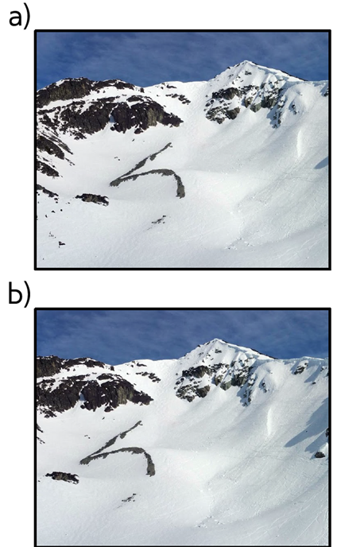
Invariance
f[x] = “mountain”
f[t[x]] = “mountain”
t: translate 20 pixels to the left

Slide 4
Invariance vs Equivariance
Invariance:
Equivariance:

Slide 5
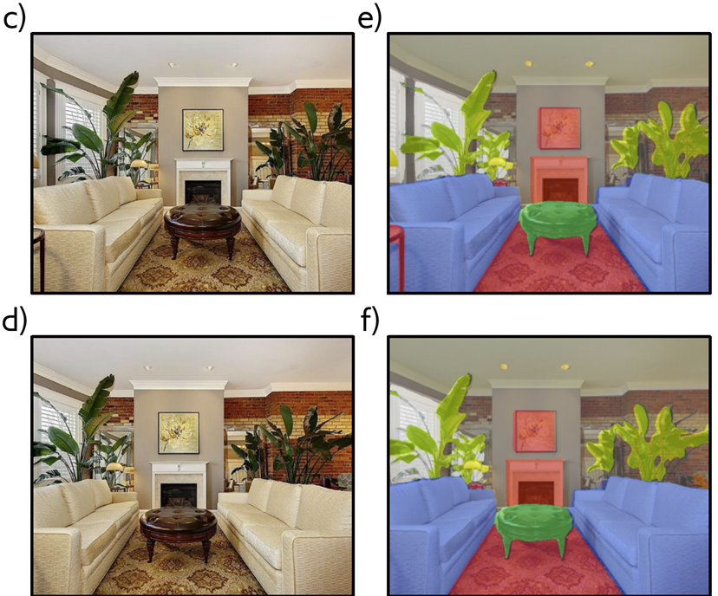
Equivariance
(translated 20 pixels to the left)
(translated 20 pixels to the left)

Slide 6
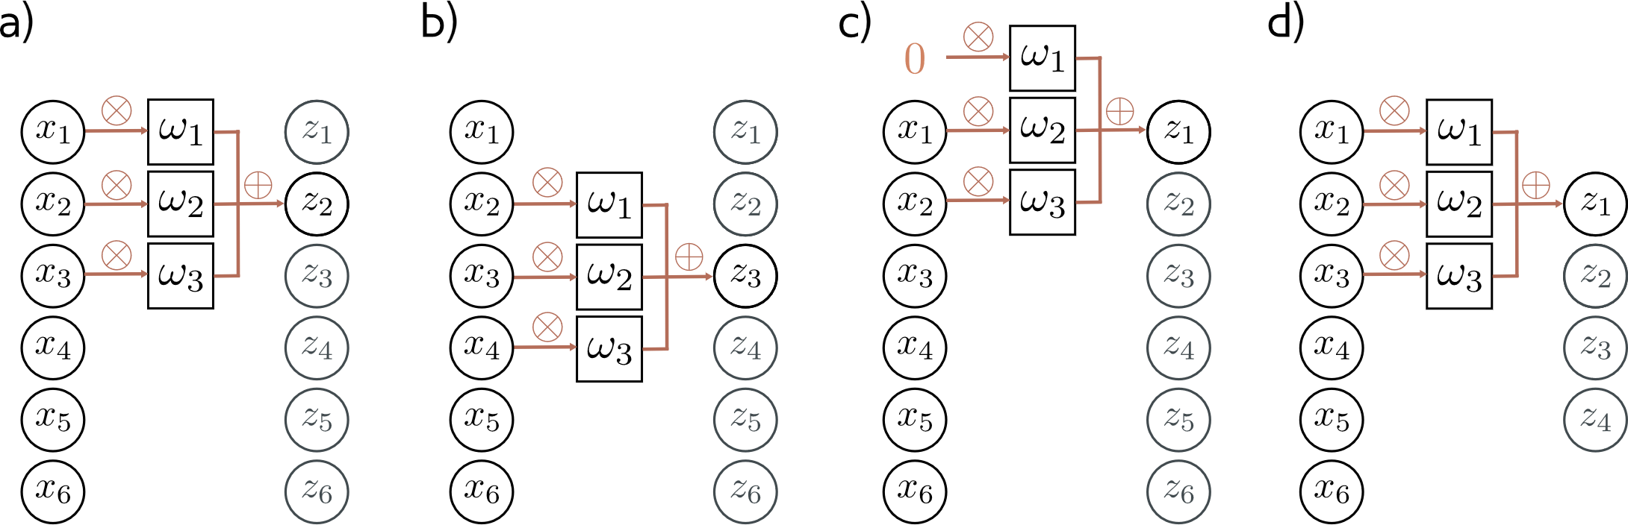
1-D convolution (for now)
Zero padding
“Valid”
padding
This work is subject to a Creative Commons CC-BY-NC-ND license. (C) MIT Press.

Slide 7
1-D convolution (for now)
Zero padding
“Valid”
padding
This work is subject to a Creative Commons CC-BY-NC-ND license. (C) MIT Press.

Slide 8
1-D convolution (for now)
Zero padding
“Valid”
padding
This work is subject to a Creative Commons CC-BY-NC-ND license. (C) MIT Press.

Slide 9

1-D convolution (for now)
Zero padding
“Valid”
padding
This work is subject to a Creative Commons CC-BY-NC-ND license. (C) MIT Press.

Slide 10
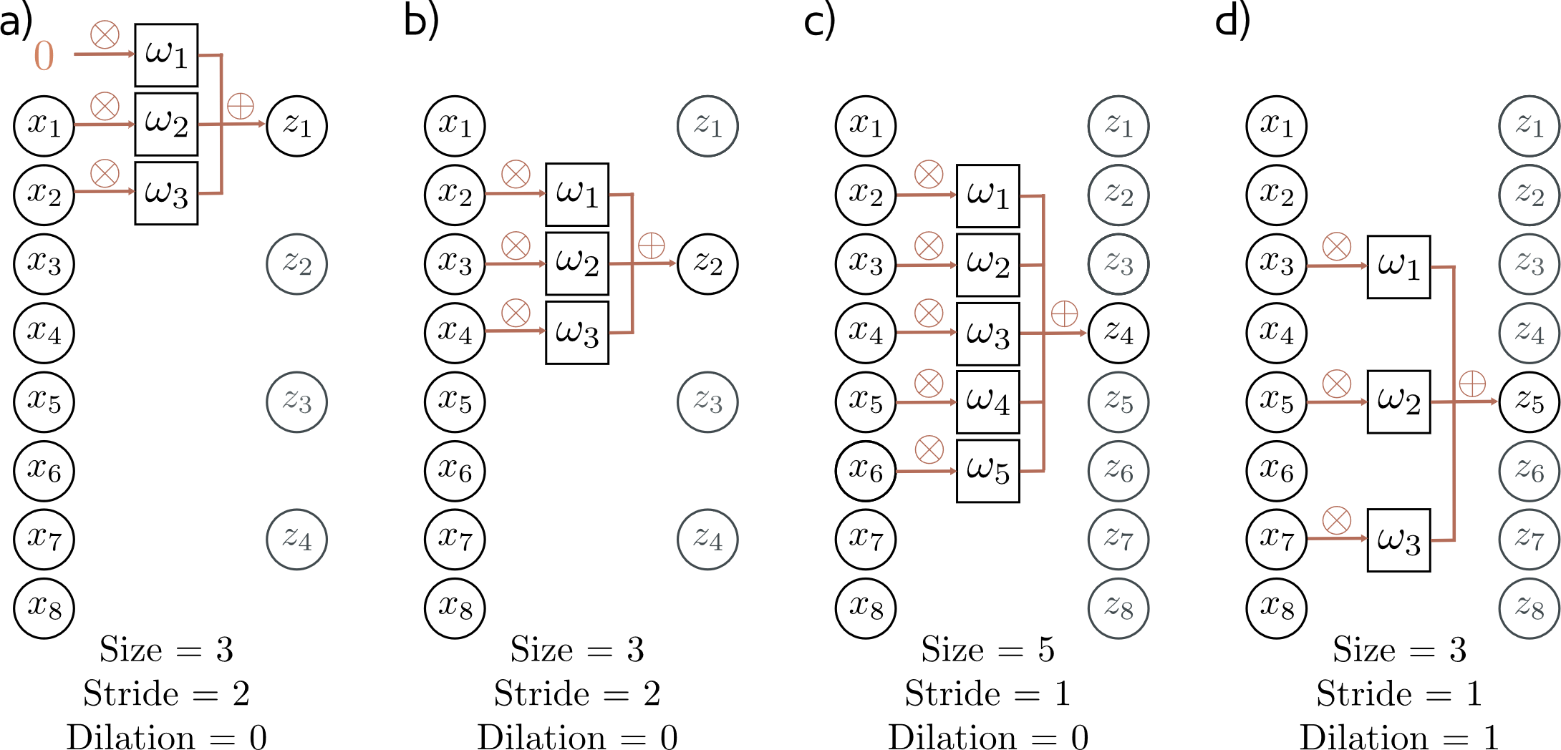



Stride / kernel size / dilation
This work is subject to a Creative Commons CC-BY-NC-ND license. (C) MIT Press.

Slide 11
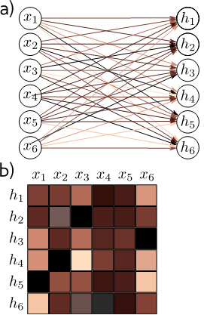
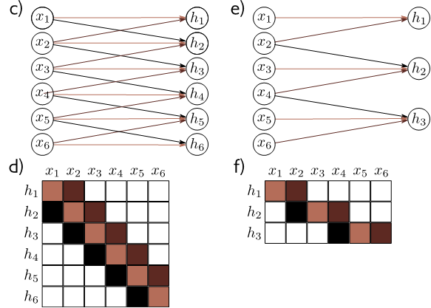


Fully connected vs convolutional layer
This work is subject to a Creative Commons CC-BY-NC-ND license. (C) MIT Press.

Slide 12
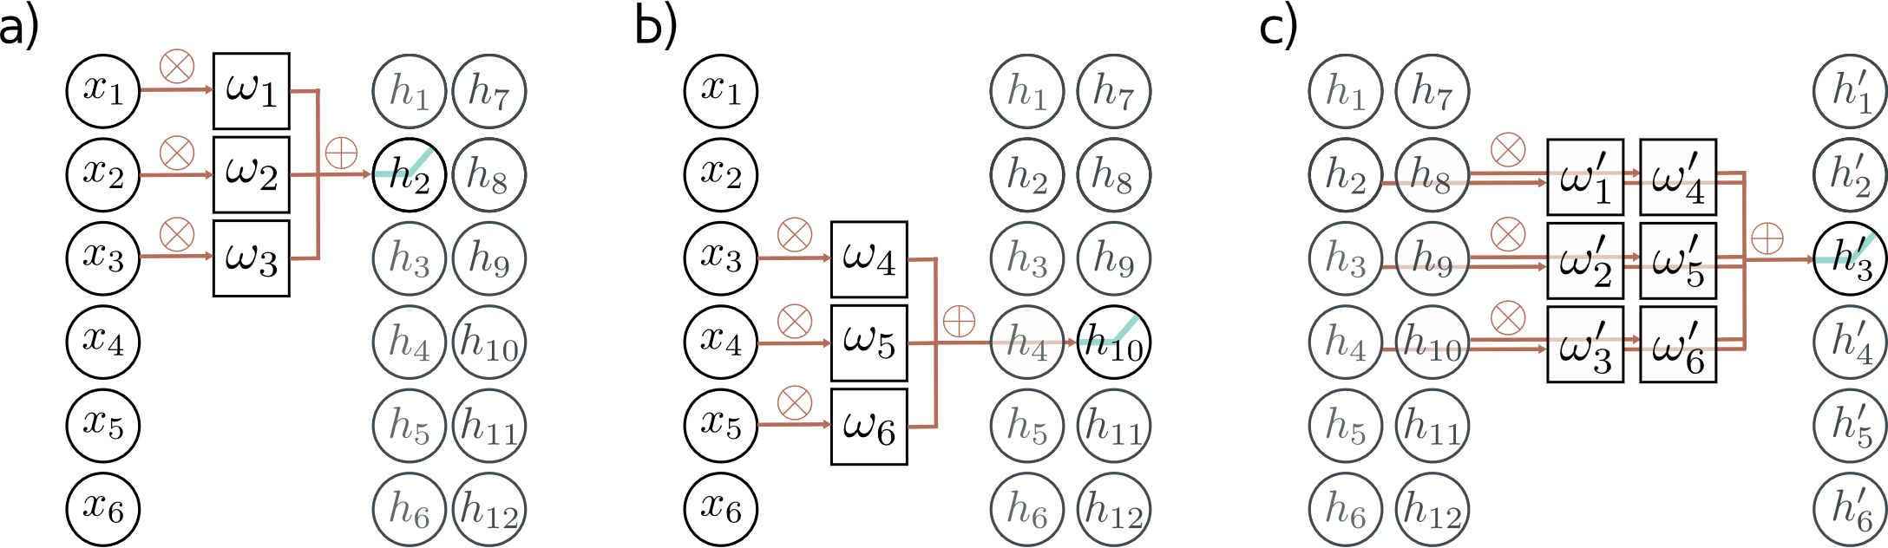
Multiple channels
Need weights and biases at each layer
This work is subject to a Creative Commons CC-BY-NC-ND license. (C) MIT Press.

Slide 13

Receptive field
What input pixels influence which units?
Receptive field increases with depth
This work is subject to a Creative Commons CC-BY-NC-ND license. (C) MIT Press.

Slide 14


Receptive field
What input pixels influence which units?
Receptive field increases with depth
This work is subject to a Creative Commons CC-BY-NC-ND license. (C) MIT Press.

Slide 15
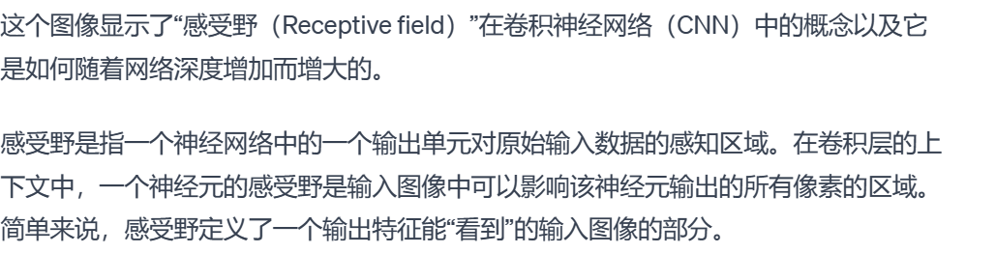
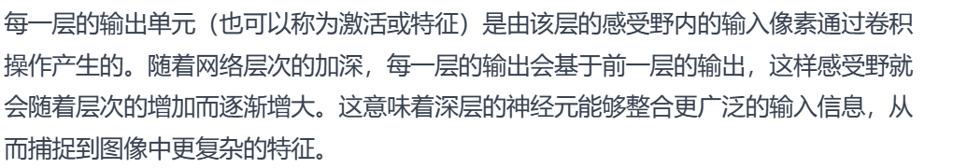



Receptive field
What input pixels influence which units?
Receptive field increases with depth
This work is subject to a Creative Commons CC-BY-NC-ND license. (C) MIT Press.

Slide 16
1-D Example: MNIST1D
Templates
Random transformation of template
Random noise
40 samples (top to bottom)
This work is subject to a Creative Commons CC-BY-NC-ND license. (C) MIT Press.

Slide 17
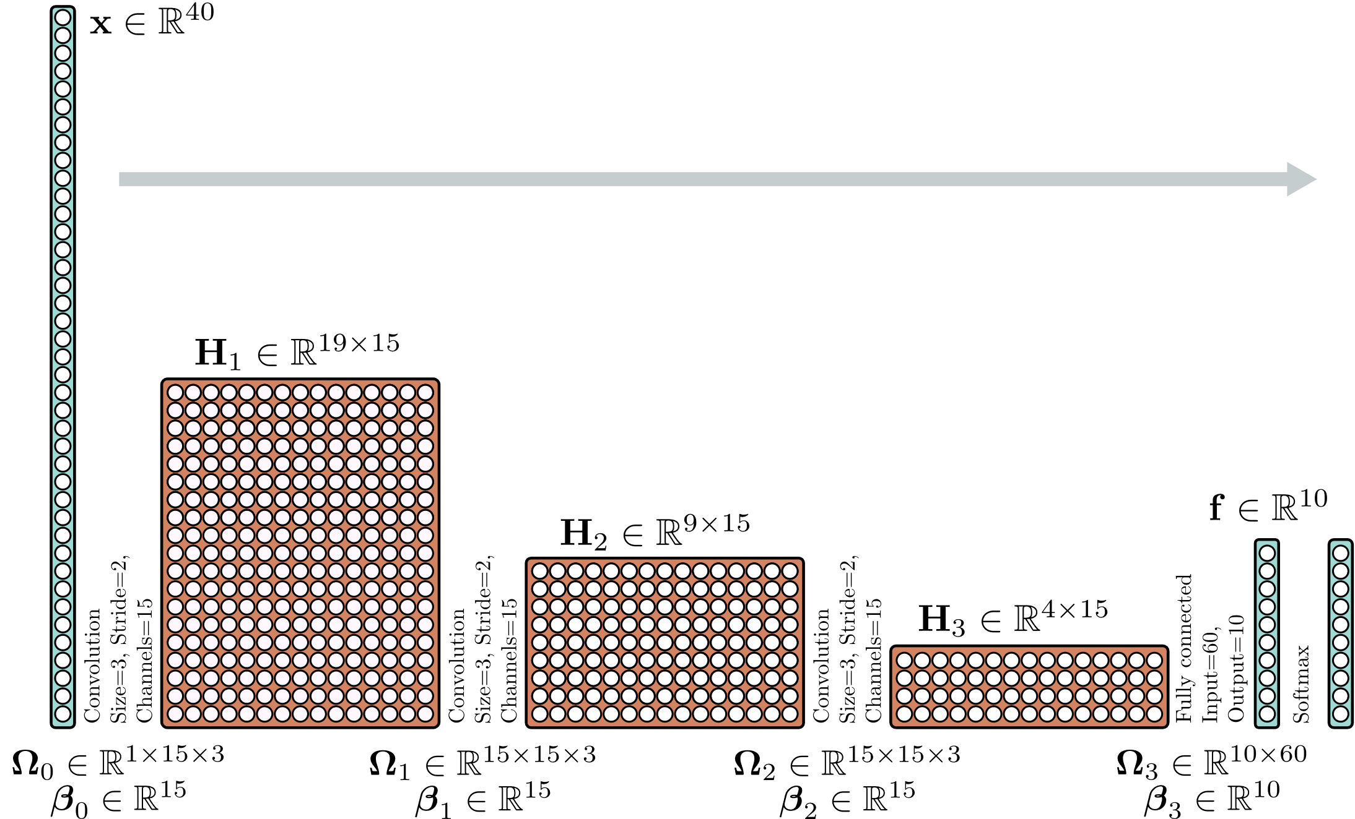
1-D Example: MNIST1D
This work is subject to a Creative Commons CC-BY-NC-ND license. (C) MIT Press.

Slide 18
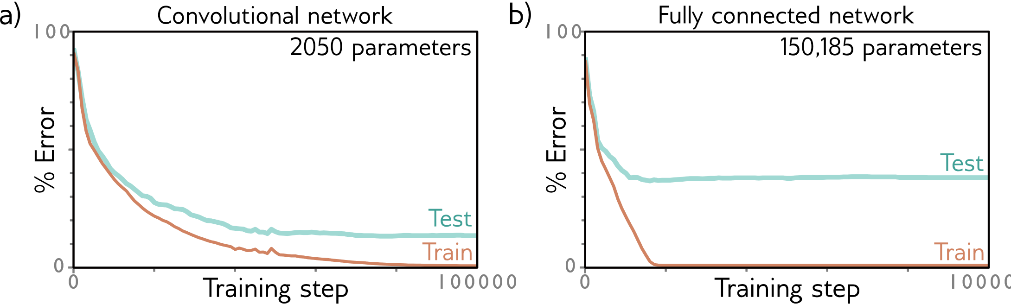
1-D Example: MNIST1D CNN vs. fully connected
2050 parameters
SGD train for 100k steps
Learning rate 0.01
Batch size 100
150,185 parameters
Same # layers / hidden units
Superior inductive bias!
This work is subject to a Creative Commons CC-BY-NC-ND license. (C) MIT Press.

Slide 19
2D convolutional layer
This work is subject to a Creative Commons CC-BY-NC-ND license. (C) MIT Press.

Slide 20
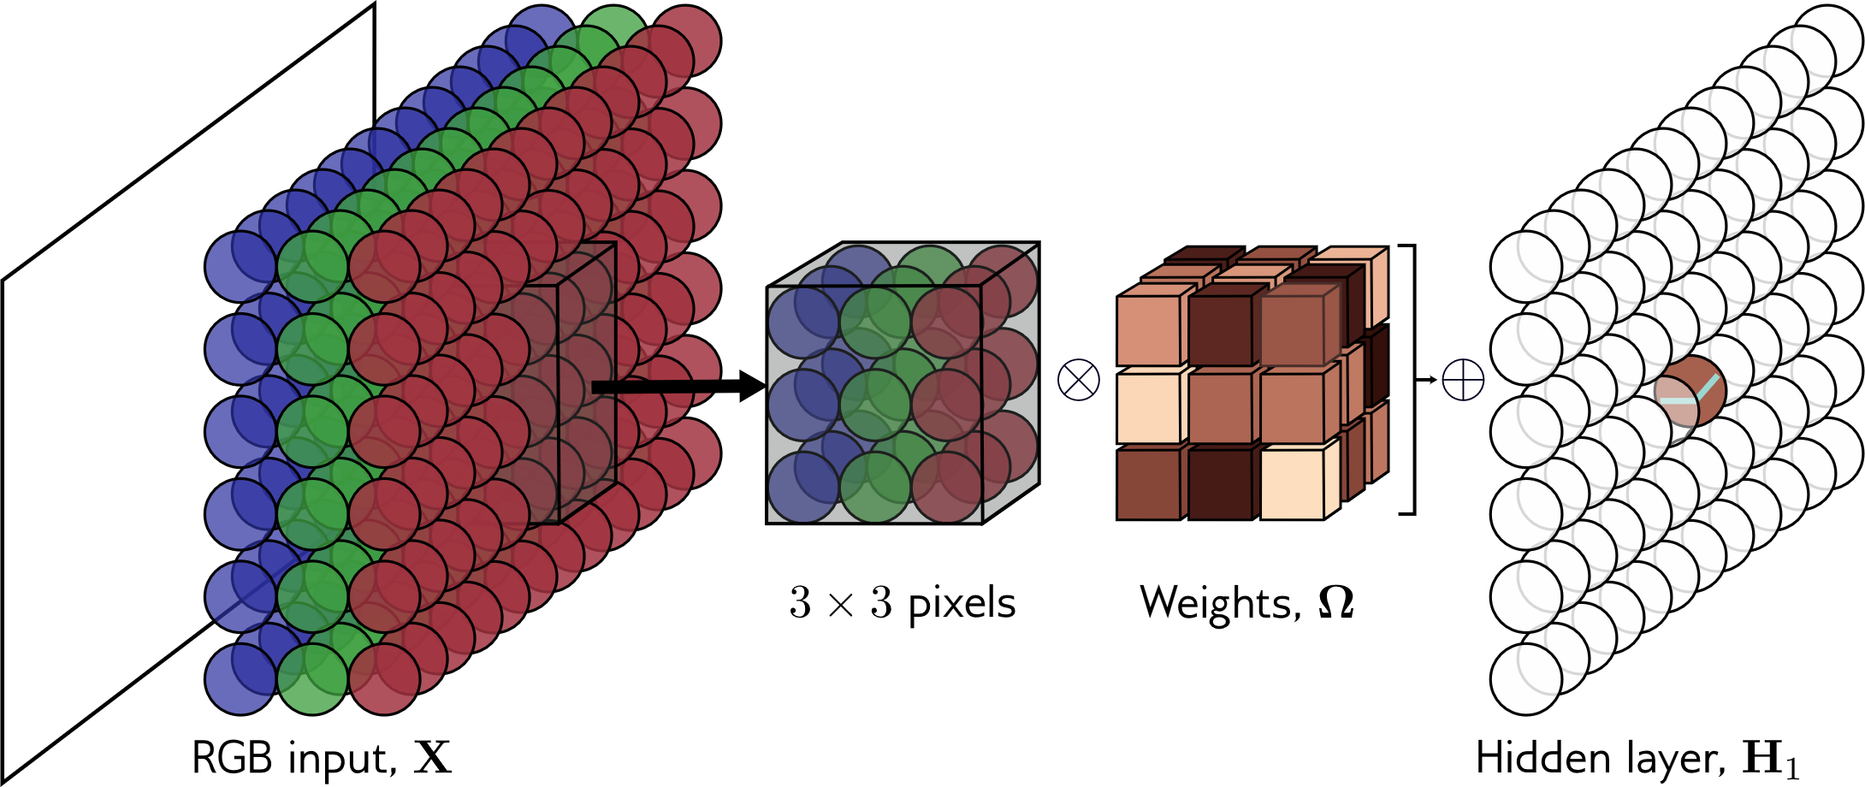
2D convolution of image
K x K x C_{i} x C_{o} weights
+ C_{o} biases
This work is subject to a Creative Commons CC-BY-NC-ND license. (C) MIT Press.

Slide 21
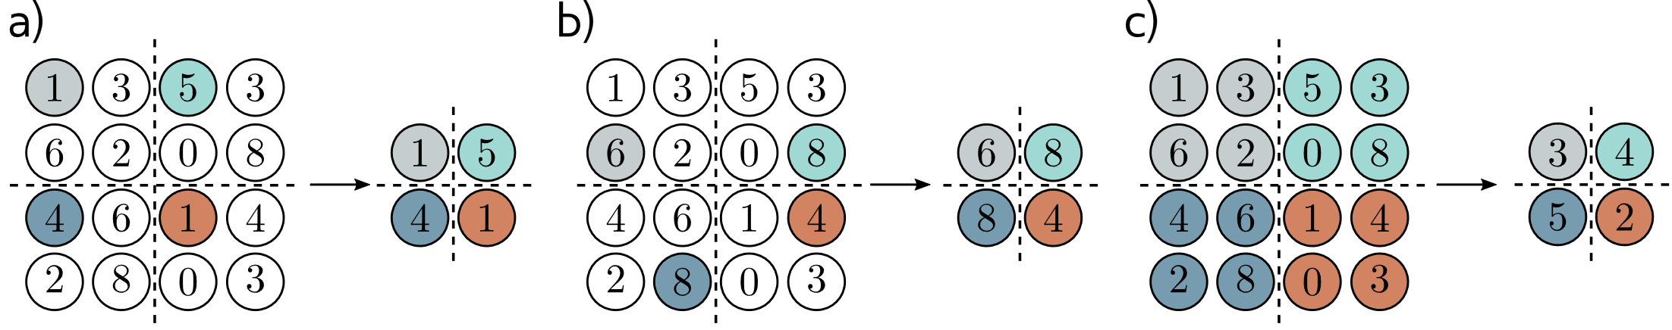
Downscaling an image 2x
a) Could sample every other pixel: stride of 2
b) Max-pooling
c) Average pooling
This work is subject to a Creative Commons CC-BY-NC-ND license. (C) MIT Press.

Slide 22
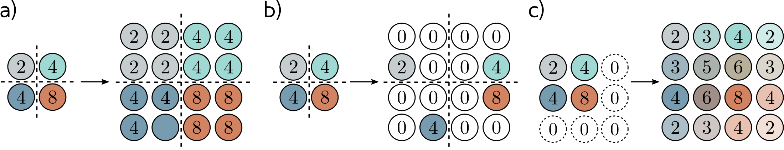
Upscaling an image 2x
a) Duplicate
b) Max-unpooling (with proper bookkeeping)
c) Bilinear interpolation
d) Transposed convolution
This work is subject to a Creative Commons CC-BY-NC-ND license. (C) MIT Press.

Slide 23
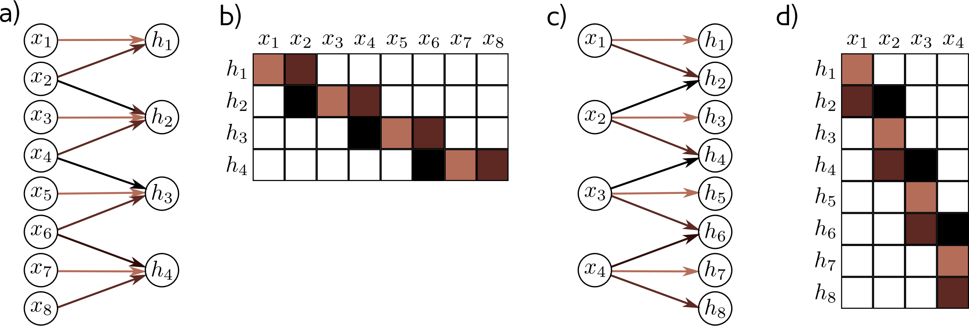
Transposed Convolution
Downsampling, stride 2
Upsampling with transposed convolution
This work is subject to a Creative Commons CC-BY-NC-ND license. (C) MIT Press.

Slide 24
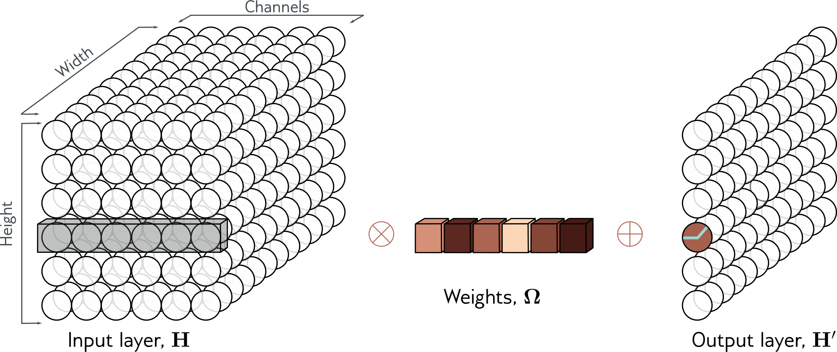


Changing the number of channels
“1 x 1 convolution” has 1 x 1 x C_{i} x C_{o} weights + C_{o} biases
Especially useful when merging CNN blocks
This work is subject to a Creative Commons CC-BY-NC-ND license. (C) MIT Press.

Slide 25
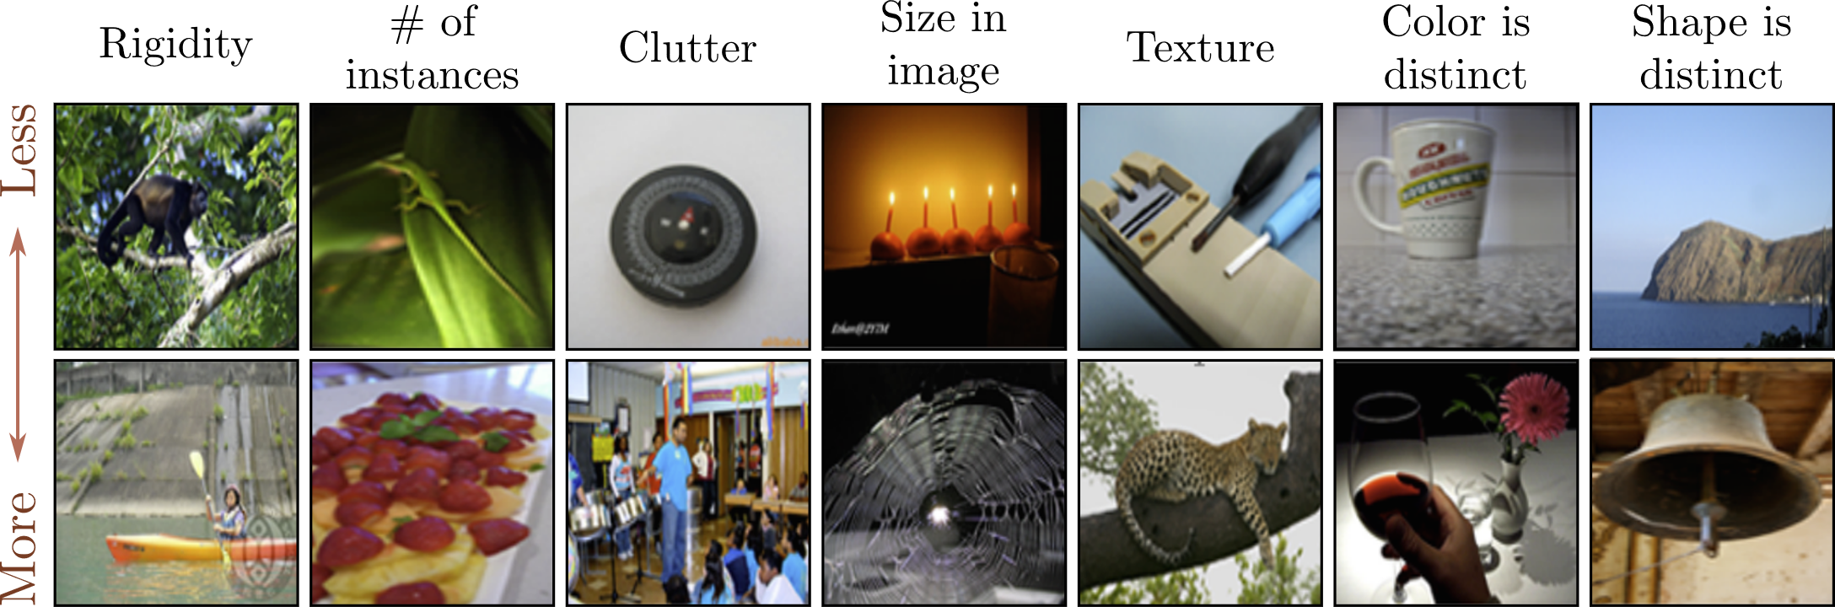
Application: Imagenet classification using AlexNet
Imagenet dataset has 1M x training images, 50k validation, 100k test
Input: 224x224 pixels
Output: 1000 categories
This work is subject to a Creative Commons CC-BY-NC-ND license. (C) MIT Press.

Slide 26
Application: Imagenet classification using AlexNet
AlexNet was first model to do well on this task
AlexNet CNN architecture:
5 hidden convolutional layers
3 hidden fully connected layers
60M parameters total
Data augmentation:
2048 x original data
Spatial transforms
Input intensities
Trained using:
SGD w/ momentum 0.9
Batch size 128
Dropout + L2 weight decay
This work is subject to a Creative Commons CC-BY-NC-ND license. (C) MIT Press.

Slide 27
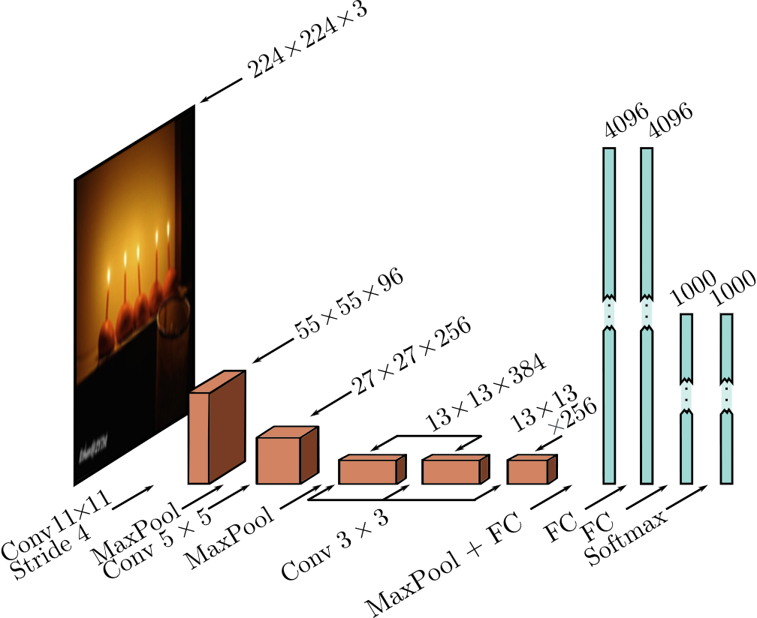
Application: Imagenet classification using AlexNet
Top-5 test error improved: from 25% in 2011 (pre-CNNs) to 16.4% using AlexNet (Krizhevsky et al. 2012)
This work is subject to a Creative Commons CC-BY-NC-ND license. (C) MIT Press.

Slide 28
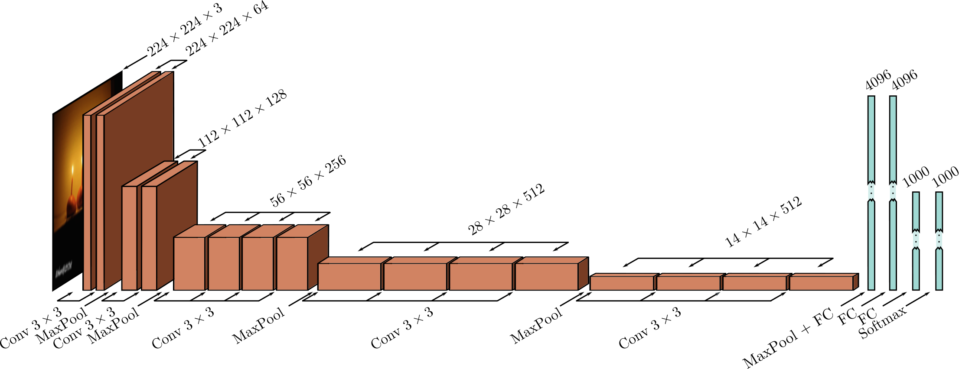
Application: Imagenet classification using VGG Net
(Simonyan & Zisserman 2014)
Test errors: 25% → 16.4% AlexNet → 6.8% VGG
19 hidden layers; 144M params (vs. AlexNet’s 60M)
This work is subject to a Creative Commons CC-BY-NC-ND license. (C) MIT Press.

Slide 29
Key Points
Convolutional vs Fully-connected layers:
Sparser connections
Shared weights
Parallel processing paths
CNN’s score better than MLP’s on images
A Harley’s Live demos of fully connected vs convolutional
Data augmentation is hugely important
CNN can help with translational equivariance
Rotational equivariance is harder
Architectural choices matter
增强

